Slide 1
Wegmans Curbside Pickup Application
Usability Evaluation Outcomes

Slide 2
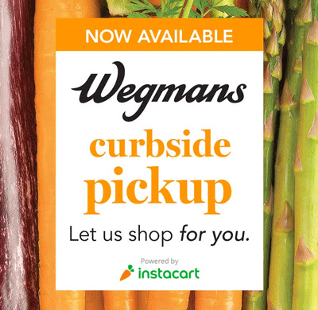
Executive Summary
Wegmans recently (January 2020) launched an in-app service called Curbside Pickup and Delivery
Users can:
  Add products in a list
  Place online orders
  Schedule curbside pick-up
Previously outsourced to Instacart
Our Role:
  Conduct usability and heuristic evaluations
  Provide insights
  Give design recommendations

Slide 3

Research questions
List-Related (Creating a Shopping List)
Can new users discover Lists easily?
How quickly can a user add items in the List to the Cart?

Slide 4
Research questions
Cart-Related (Getting Your Cart Ready)
Can the users easily Filter items in-store?
Is the lack of error prevention mechanism on the Filter Menu noticed by the users?
Is the frequently used option of deletion optimized?
How easy is it for the users to add special Notes and Substitutions?
Notes:
The first two questions could not be answered due to an issue with the relevant task scenario.

Slide 5
Research questions
Checkout-Related (Only if time slots are available)
How fast is the Checkout process?
Are constraints during the Checkout process clearly displayed?
Can the user quickly change the pickup location and time?

Slide 6
Research questions
General Questions (Post-Test)
Did the user have a smooth shopping experience?
Will the user prefer this method of shopping over in-store shopping?
Will the user recommend this app to a friend?

Slide 7


Participants
EXPERT
NOVICE
PILOT
PILOT
AGE : 50+ YEARS
AGE : 50+ YEARS
AGE : 23-25 YEARS
AGE : 24-26 YEARS
AGE : 28-30 YEARS
AGE : 28-30 YEARS
iPHONE v.7 +
ANDROID v.7 +
Notes:
We recruited expert users with the help of our client. She connected us to Wegmans insiders customers, who often provide feedback. Both expert users ordered groceries for pickup often, upto 6 times a month.

Slide 8

Tasks and scenarios
Background setting: The participant is planning a party and is in charge of getting the supplies.
Create a new list (Think aloud)
Add items to the shopping list (Timed)
Filter items (Think aloud)*
Delete items from the list (Timed)
Move items from the list to cart (Think aloud)
Notes:
We created two sets of task descriptions, for the two types of participants. The expert users were planning for their niece’s graduation party, and the novice users were planning for their sister’s graduation party. All the tasks were related to this background setting. The “Filter Items” task was the only one with an unclear scenario. We were not able to get good data specific to this feature because of this.

Slide 9
Tasks and scenarios
Add notes and substitution (Think aloud)
Add items to cart (Timed)
Delete item in the Cart (Think aloud)
Cancel checkout (Timed)
Notes:
We alternated time-on-task and think-aloud tasks.

Slide 10

Study Design
Sessions were conducted from May 1-3, 2020, via Zoom Meetings
Participants used laptops (video) and mobile phones (audio and screen-sharing)
One Moderator, two Observers, and one Tech. Supervisor
Test Materials were sent via email. All questionnaires were Google Forms
Participants conducted Timed and Think-Aloud Tasks alternatingly

Slide 11
Results

Slide 12
Time on Task
Task Description | P1 (s) | P2 (s) | P3 (s) | P4 (s) | Average Time (s)
Add items to the shopping list | 51 | 195 | 80 | 121 | 111.75
Delete items from the list | 12 | 42 | 26 | 30 | 27.5
Add items to cart | 115 | 240 | 150 | 291 | 199
Delete items from the list | 15 | 0 | 150 | 22 | 46.75
Total Time | 193 | 477 | 406 | 464

Slide 13
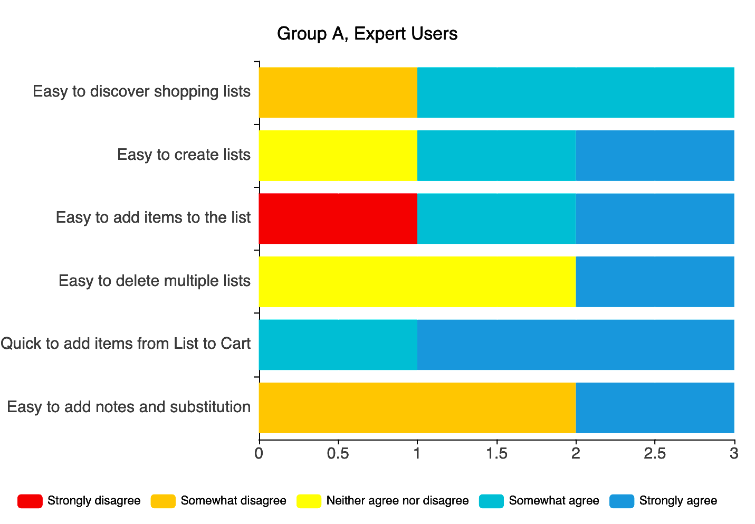
Post-Task Survey
Shopping List
Some expert users encountered problems when using the shopping list

Slide 14
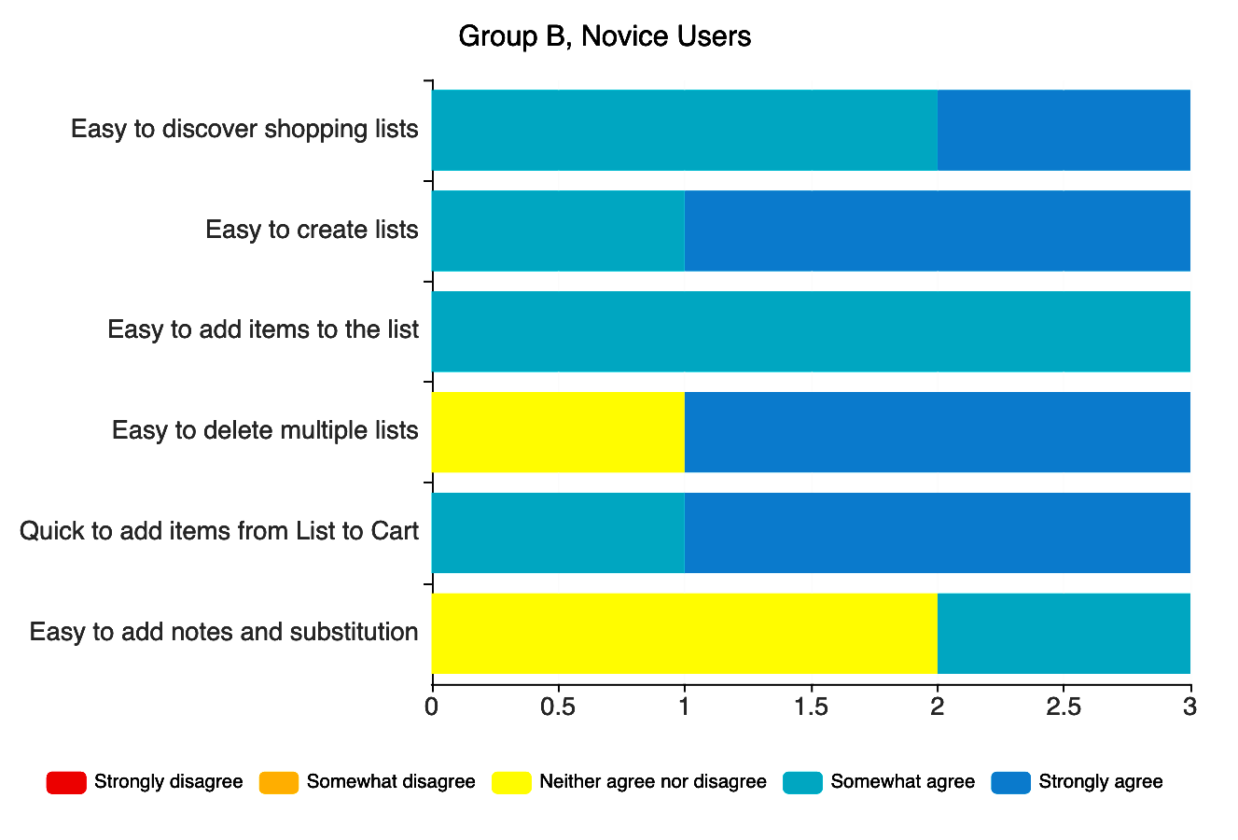
Post-Task Survey
Shopping List
Tasks are generally easy for novice users

Slide 15
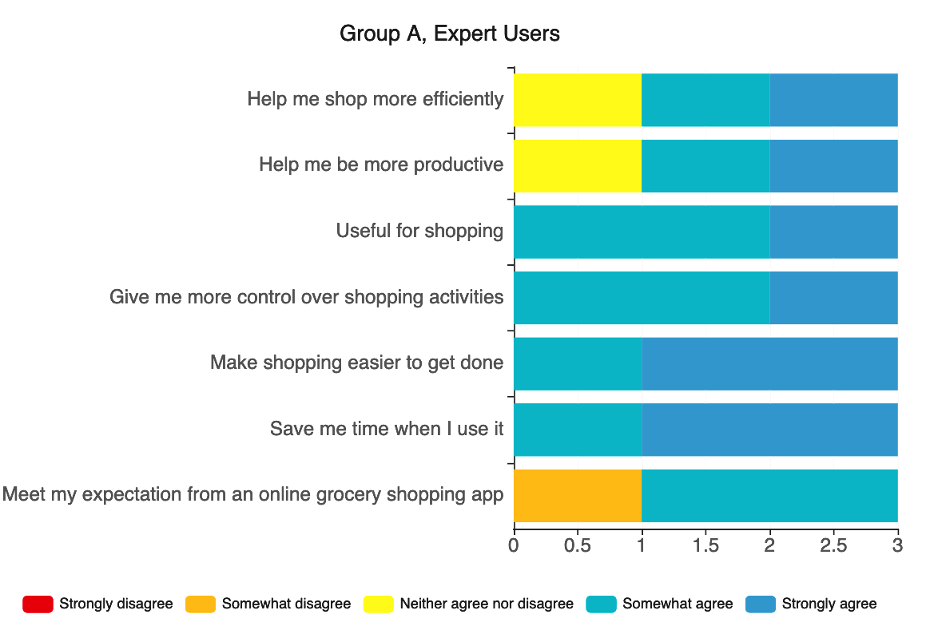
Post-Task Survey
Usefulness
Expert users find it generally useful

Slide 16
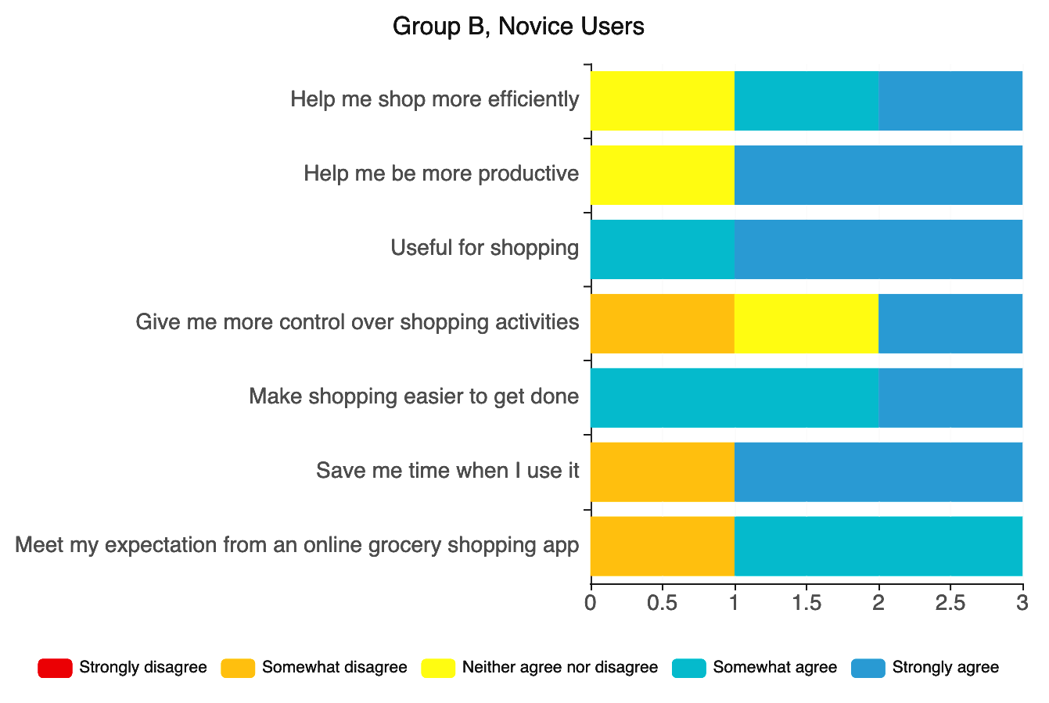
Post-Task Survey
Usefulness
Novice users do not find it as useful as expert users

Slide 17
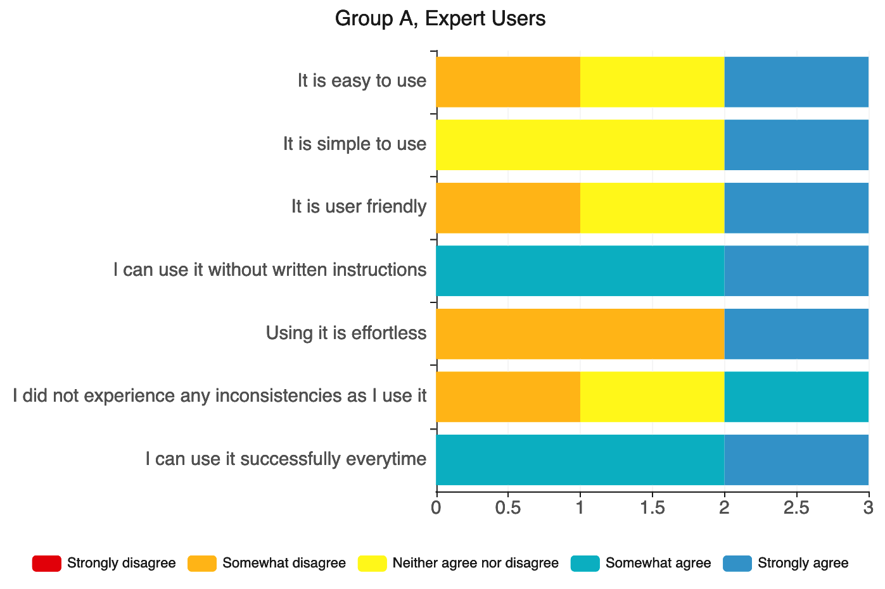
Post-Task Survey
Ease of Use
Expert users find the app not very easy to use

Slide 18
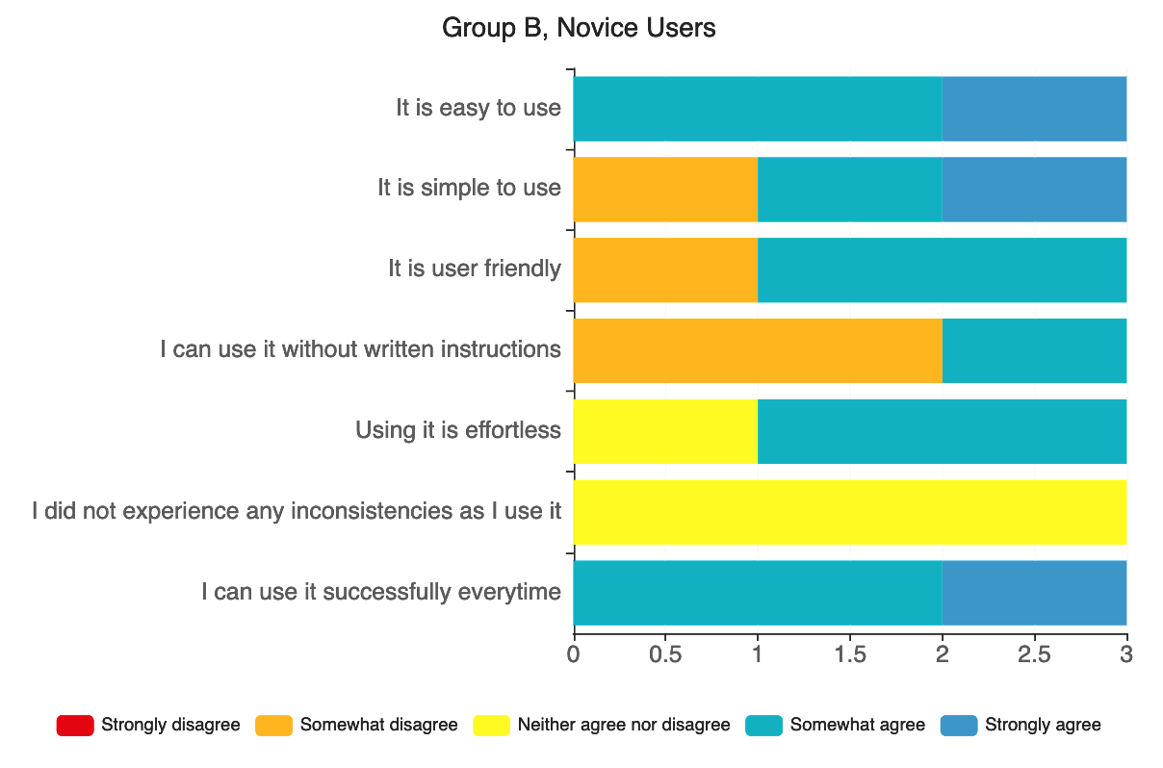
Post-Task Survey
Ease of Use
Novice users find it easier to use than expert users

Slide 19
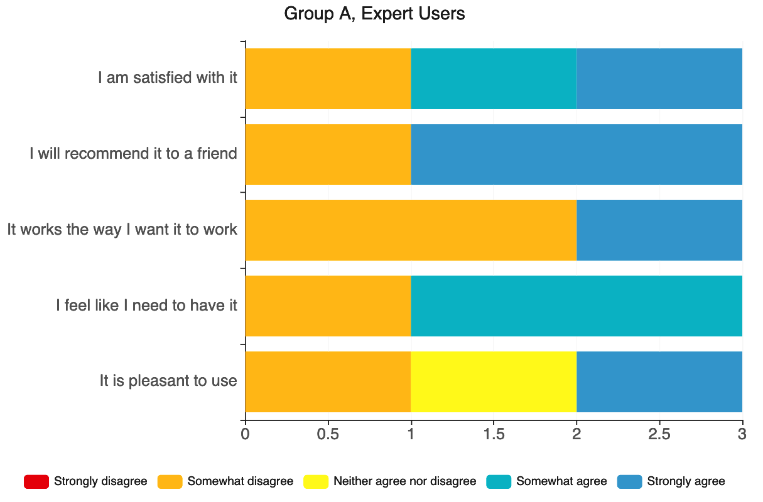
Post-Task Survey
Satisfaction
It does not satisfy expert users as expected

Slide 20
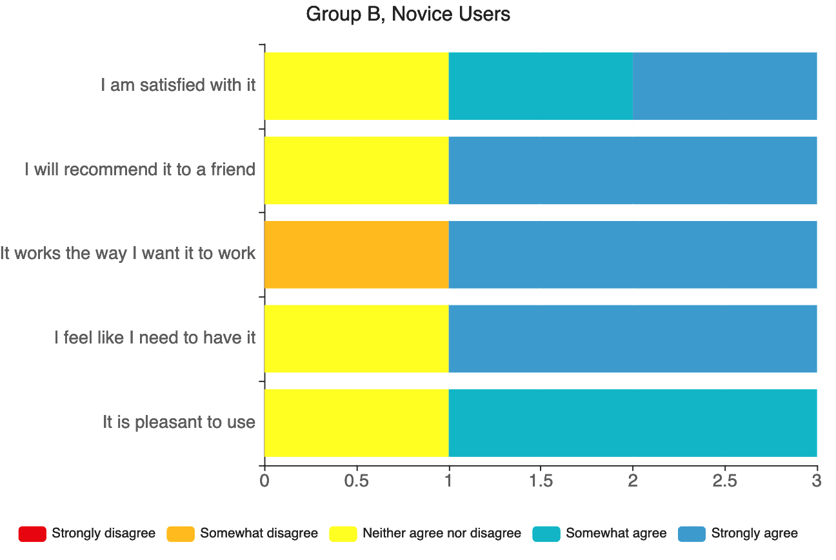
Post-Task Survey
Satisfaction
Novice users are more satisfied than expert users

Slide 21

Summary: P1 (Expert User)
The participant was well versed with the application and prefers storing the items in the shopping cart over the list
The participant gave up trying to add items in the list after several failed attempts
The participant appreciated the instructions option in the product page
Notes and substitutions option in the cart did not seem clickable to the participant

Slide 22
Summary: P2 (Expert User)
Prefers the older version (Homepage is too cluttered, and the text is also too small)
Already has multiple shopping lists in her account
Used the search bar to find gluten-free items (When she is looking for vegan items she will use the filter)
P2 thinks that the shopping list should also be on the Homepage
Clicked the Kabab Menu before Notes and Substitutions, which is wrong before she clicked the text and successfully complete the task

Slide 23
Summary: P3 (Novice User)
The list was a guided discovery
P3 preferred the search bar. She noticed the “GF” icon on the home page. She recognised but did not think to use the filter option
Confusion with “My List”
Added items one-by-one. “Add to Cart” was a guided discovery
Looked for “instructions”. She again spent some time to find the option to add notes and noticed “notes and substitution“ at the top after 17 seconds
Ended up deleting all items one by one. She said she was searching for “Delete All” but could not find it

Slide 24
Summary: P4 (Novice User)
P4 added items to the Cart and assumed it will be added to the List, too
P4 mentioned that multiple quantities cannot be added to the List at once
Prefers Search (Easy to type in). Mentioned that Filtering takes more clicks and more time
Was not aware about Notes and Substitutions. When told, was pretty impressed but was unable to find it. Clicked on Notes and Substitution but instead opens Kebab Menu (happens twice)

Slide 25


Research Questions and Answers
List-Related (Creating a Shopping List)
Cart-Related (Getting Your Cart Ready)
Checkout-Related (Only if time slots are available)
General Questions (Post-Test)

Slide 26
Usability Issues

Slide 27
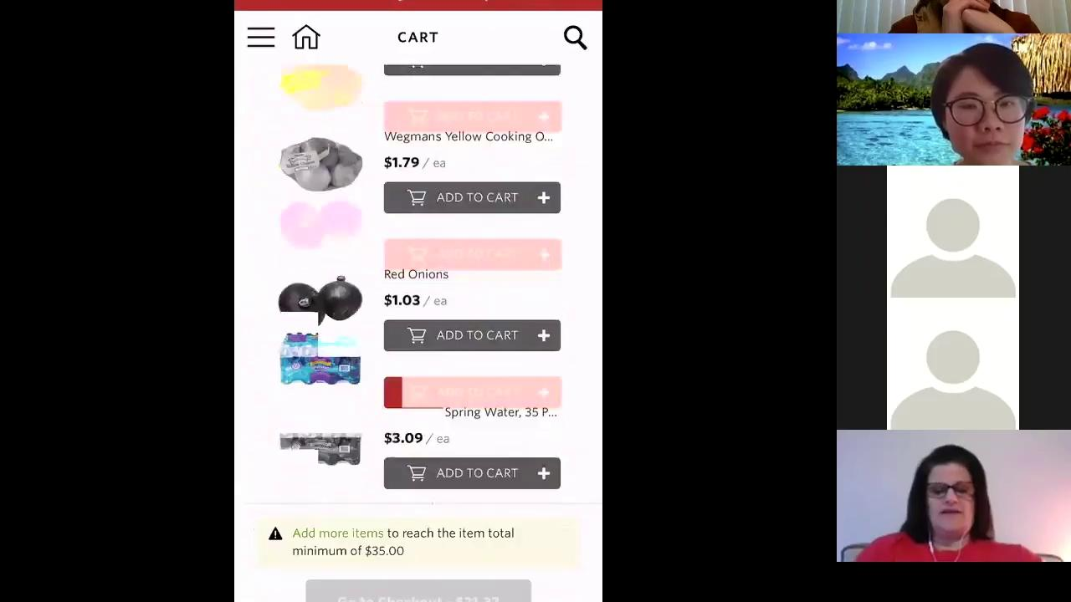
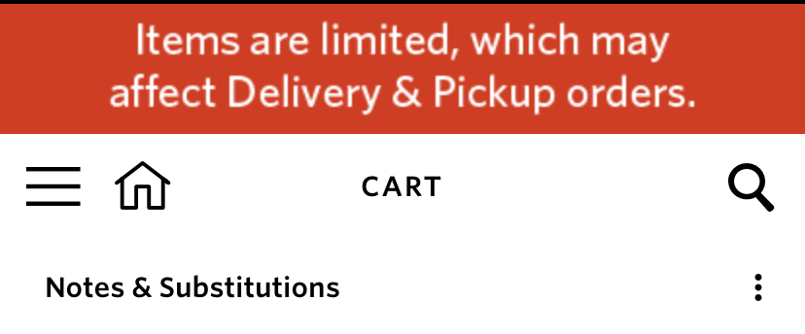
Issue 1: Find “Notes and Substitutions”
The “Notes and Substitutions” feature is not perceivable to participants.
Look for this!

Slide 28
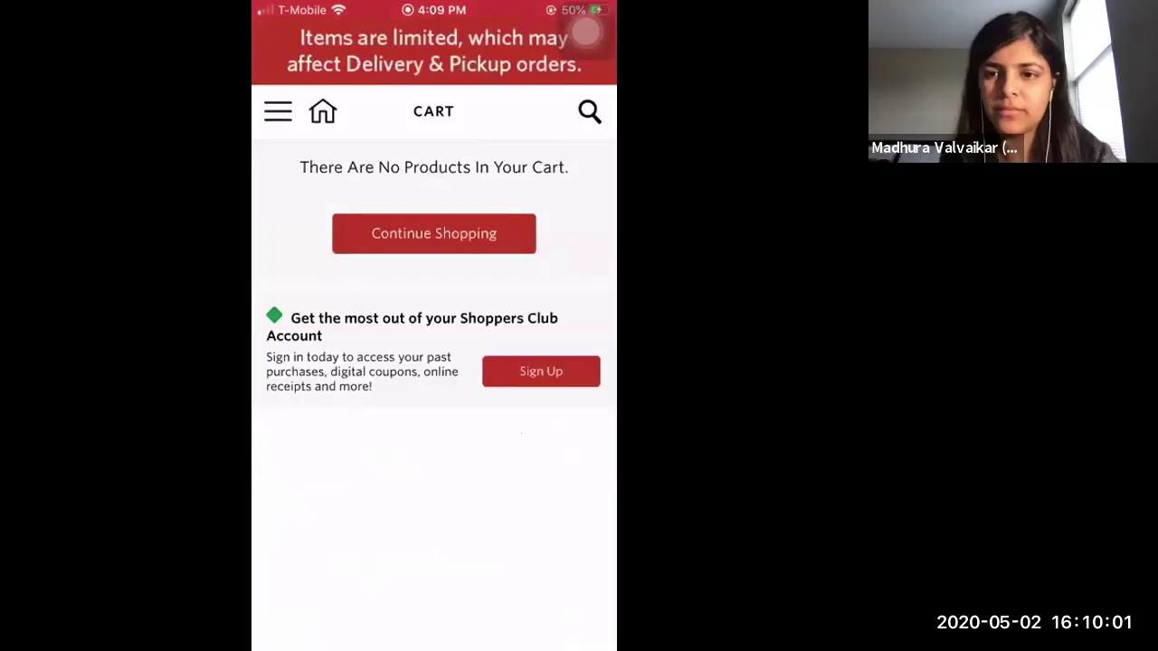
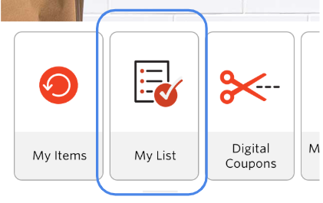
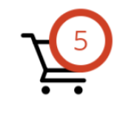
Issue 2: “My List” Confusion
Participants got confused between “My Cart” and ”My List”

Slide 29
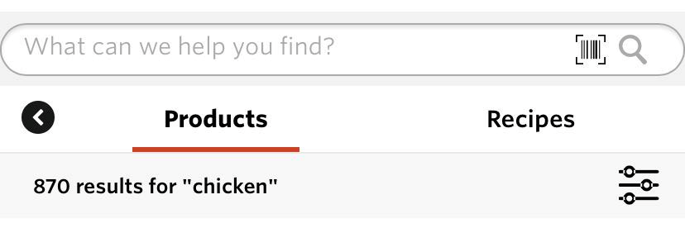
Issue 3: Filter In-Store Items
Participants tend to search for product keywords directly instead of using filter feature. This was an issue with the task scenario.

Slide 30
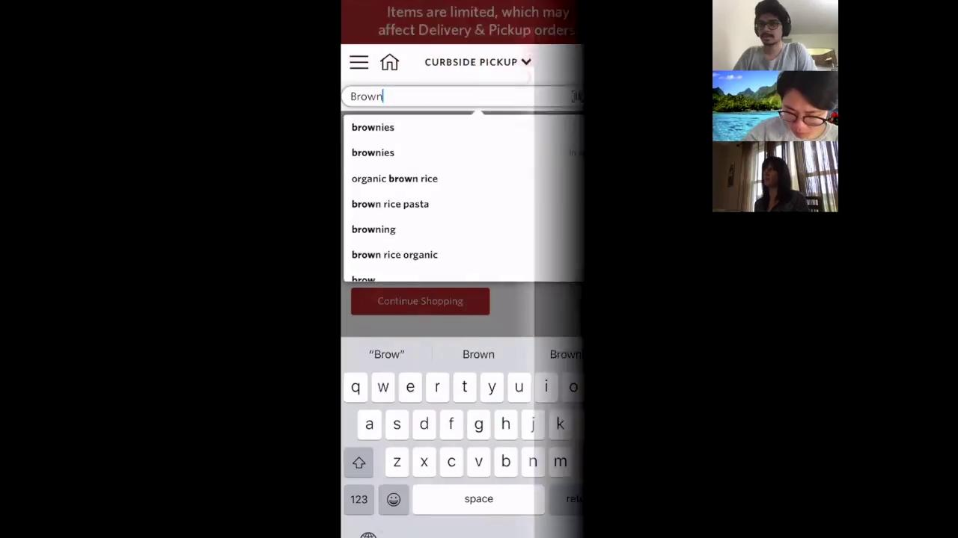
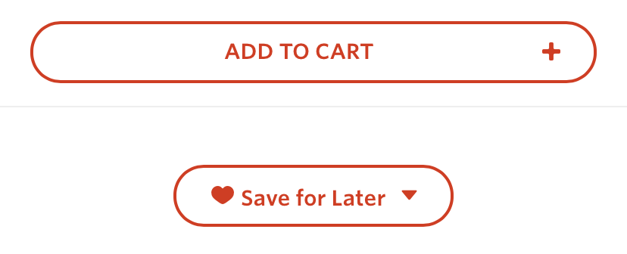
Issue 4: Add items to Saved List
Some participants have trouble finding the “Save for Later” button under item info page.

Slide 31
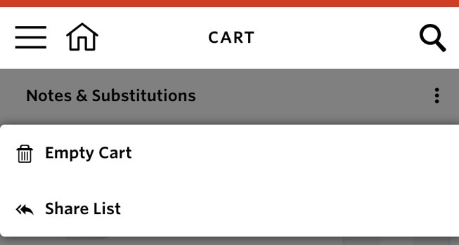
Issue 5: Delete All Items from the Cart
Some participants, instead of using “Empty Cart,” they deleted items one by one.

Slide 32
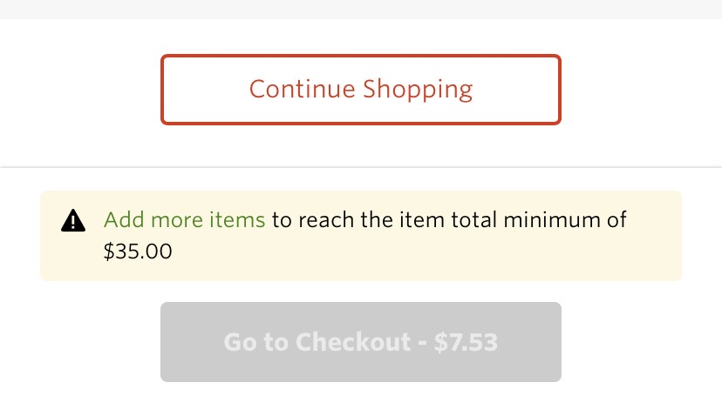
Issue 6: Warnings at Checkout Page
Some participants failed to notice the warning at the bottom of the page.

Slide 33

List of Issues (in decreasing order of criticality)
Find “Notes and Substitution”
Add items to Saved List
“My List” vs “My Cart” Confusion
Filter In-Store Items
Delete All Items from the Cart
Check Out
Equal Criticality

Slide 34

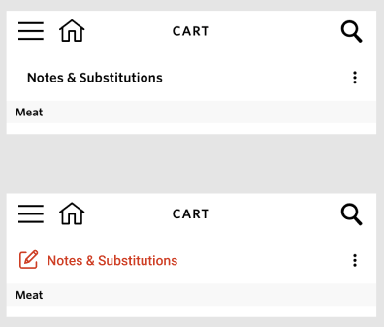
Design Recommendations
Notes and Substitutions:
Consider changing the font color so it looks clickable. Also consider including an icon with a notepad and pen, to indicate its function.
(Internal Consistency with other clickable items in the app)

Slide 35
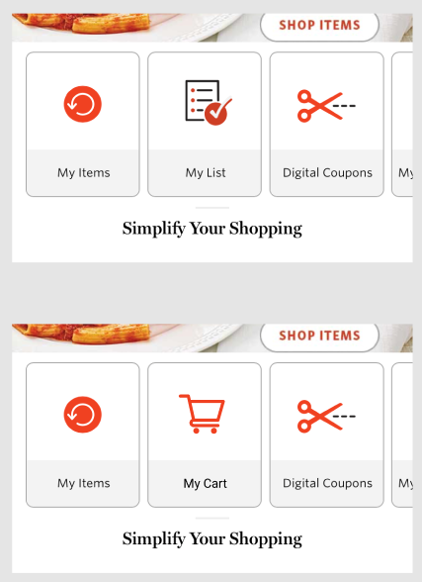
Design Recommendations
”My List” vs. “My Cart”:
Consider changing the card on the Homepage titled “My List” to “My Cart”, since it directs the user to the Shopping Cart. Also change the icon accordingly.
(External Consistency with the “cart” feature in other apps, and effective mapping of function)

Slide 36
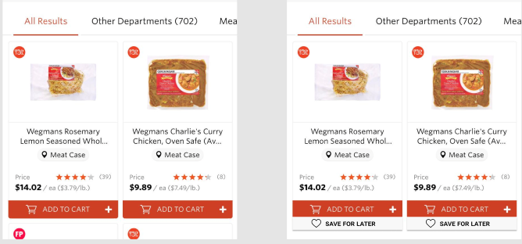
Design Recommendations
Add Item to Saved List:
Consider including an option under/near the “Add to Cart” button underneath each item’s description.

Slide 37
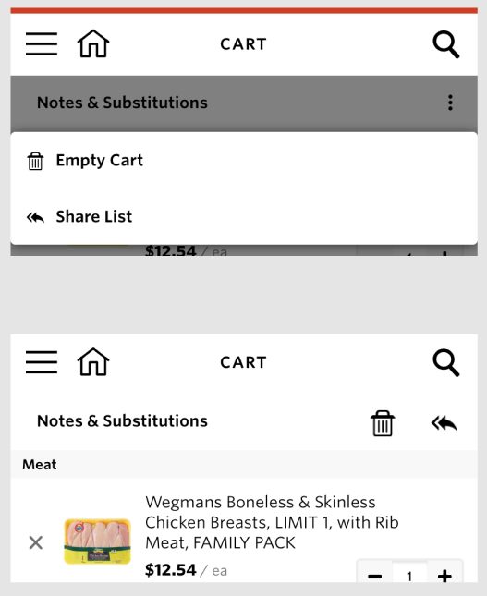
Design Recommendations
Kebab Menu (Next to Notes and Substitutions):
Consider displaying the options “Empty Cart” and “Share List” beside “Notes and Substitutions”.
(Optimising frequently used functions)

Slide 38
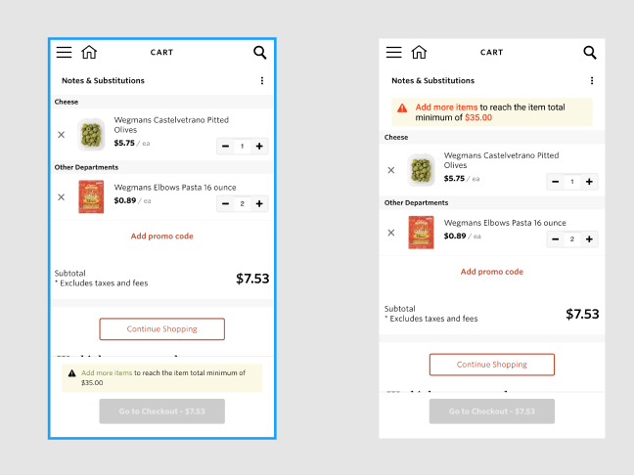
Design Recommendations
Check Out:
Consider moving the “Minimum Price” notification to a more visible spot. Alternatively, display as a feedback to clicking Checkout button.
(Visibility of System State)

Slide 39
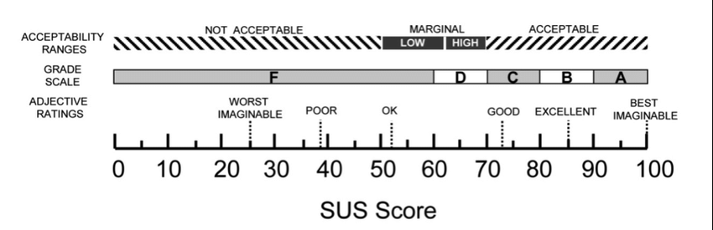
SUS Score (More Good than OK)
Wegmans Curbside Pickup App
65.83%

Slide 40

Future work
Study in lab-setting
  Avoid connection problems
  Avoid device differences
  Avoid unexpected text messages and phone calls
Use more specific task scenarios to test Filtering, saving Recipes, etc.

Slide 41
Thank you!

